Slide 1
Final Project: Forecasting Canada’s Nominal GDP
Forecasting Canadian GDP Using Machine Learning and Macro-economic Variables
By: Madiha, Fatima and Tanvir

Slide 2
Project Overview
Overview
Intro to Macroeconomics(Background)
Forecasting GDP(Importance)
Conclusion
Notes:
Presenter: CH

Slide 3




Data Mining and Pre-processing
The dataframe, as retrieved from the World Bank database:
Country name | Macroeconomic variable | Year 1 | Year 2 | Year3
Country 1 | Variable 1 | Value | Value | Value
Country 1 | … | … | … | …
Country 1 | Variable 12 | Value | Value | Value
Country 2 | Variable 1 | Value | Value | Value
Country 2 | … | … | … | …
Country 2 | Variable 12 | Value | Value | Value
Source
Dataset
Wide to long format conversion of 3D dataset
The dataframe, after ETL:
ETL
Country name | Year | Macroeconomic variable 1 | Macroeconomic variable 2 | … | Macroeconomic variable 12
Country 1 | Year 1 | Value | Value | Value | Value
Country 2 | Year 2 | Value | Value | Value | Value
… |  | … | … | … | …
Notes:
Initial drafter: EC

Slide 4
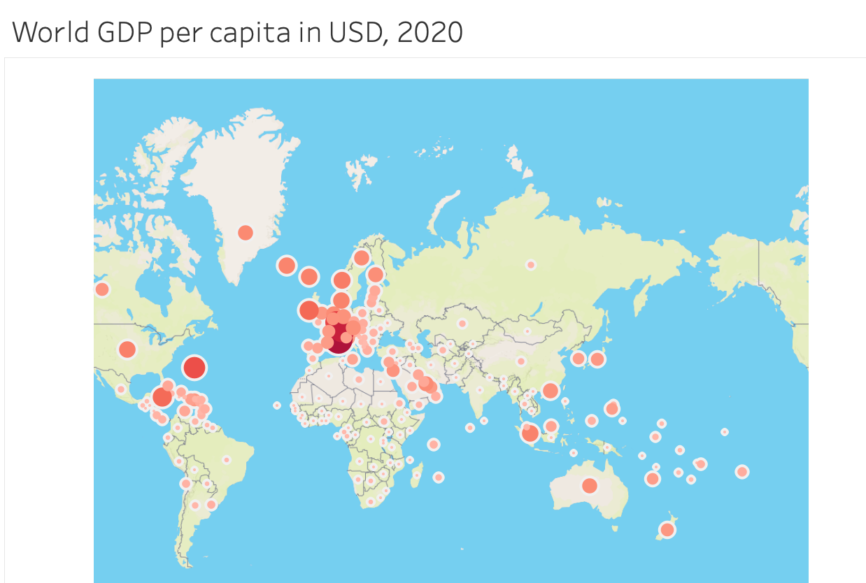
Canadian GDP Per Capita
Almost USD 2 Tr. in GDP as of 2020.
Since 2000, on average:
- Between 6% and 11% of GDP was allocated to health expenditure;
- Globally, Canada is in the top 20 in terms of GDP per capita as of 2021 .
Notes:
Presenter: CH

Slide 5
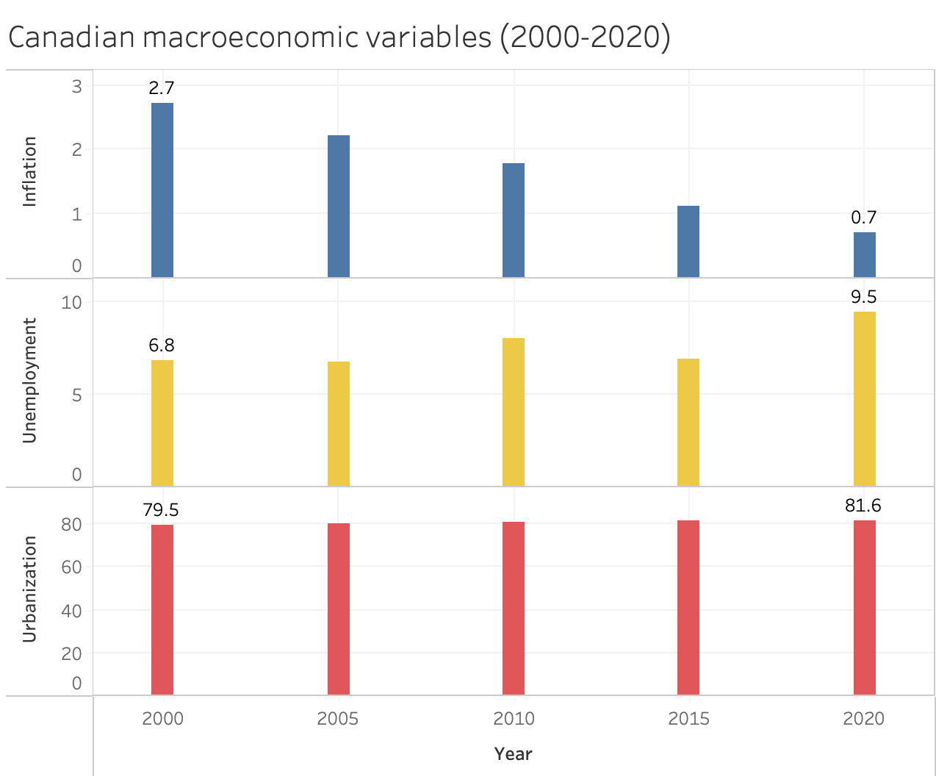
A Snapshot of the Canadian Economy
Stable inflation rate at, on average 2% per year.
Unemployment rate is around 7%, on average.
82% of Canadians live in cities, as of 2020.
Notes:
Presenter: CH

Slide 6
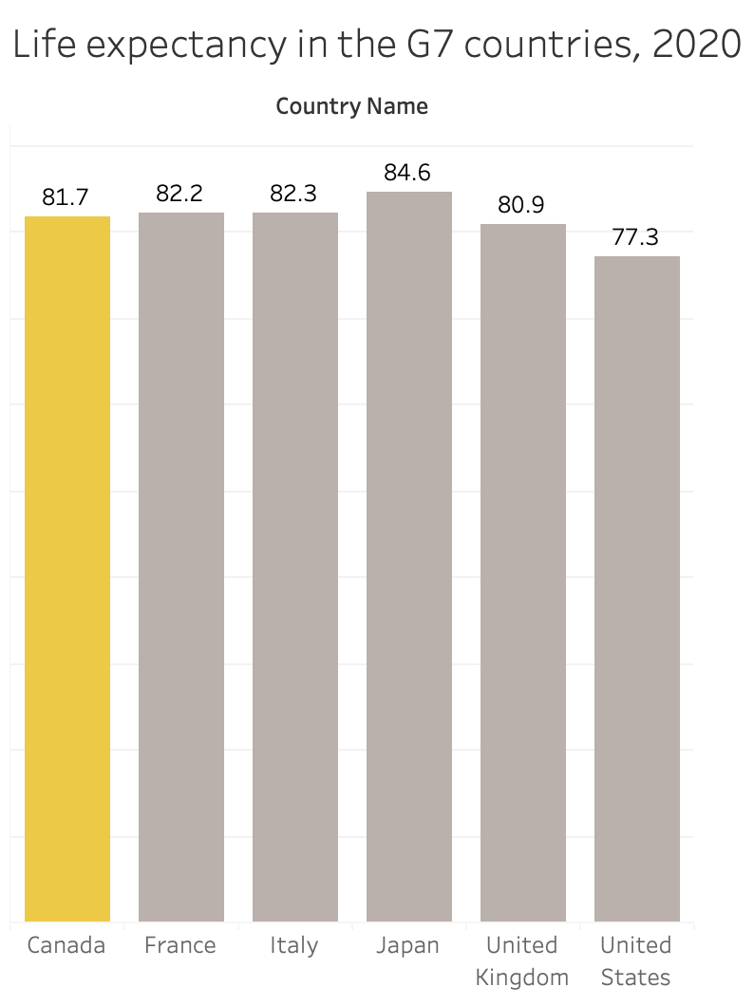
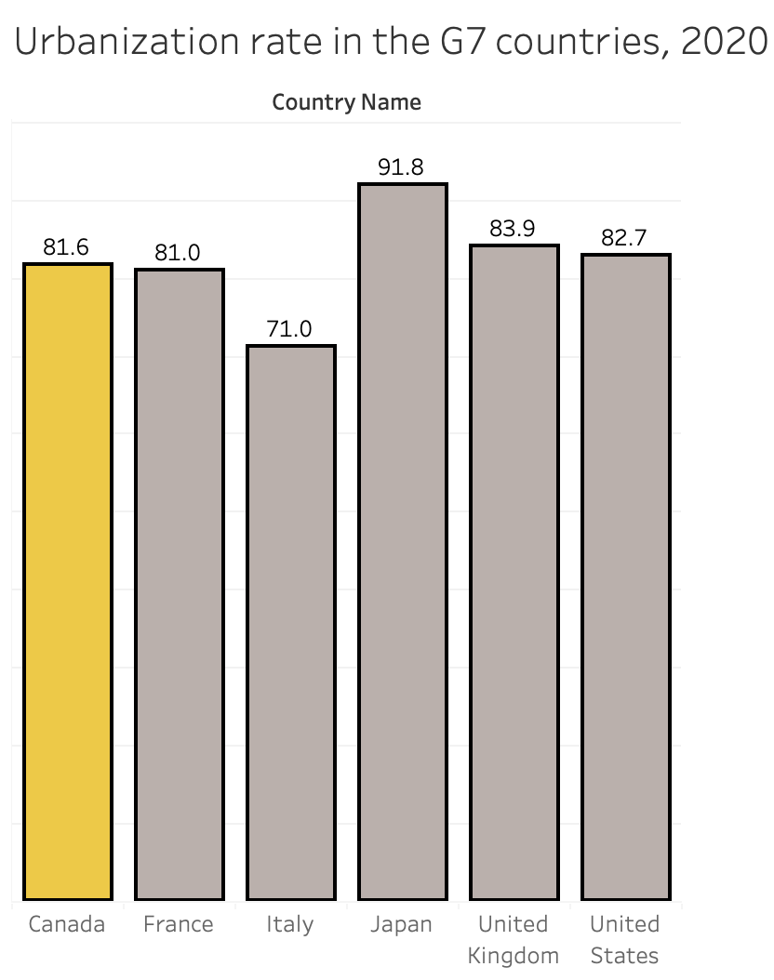
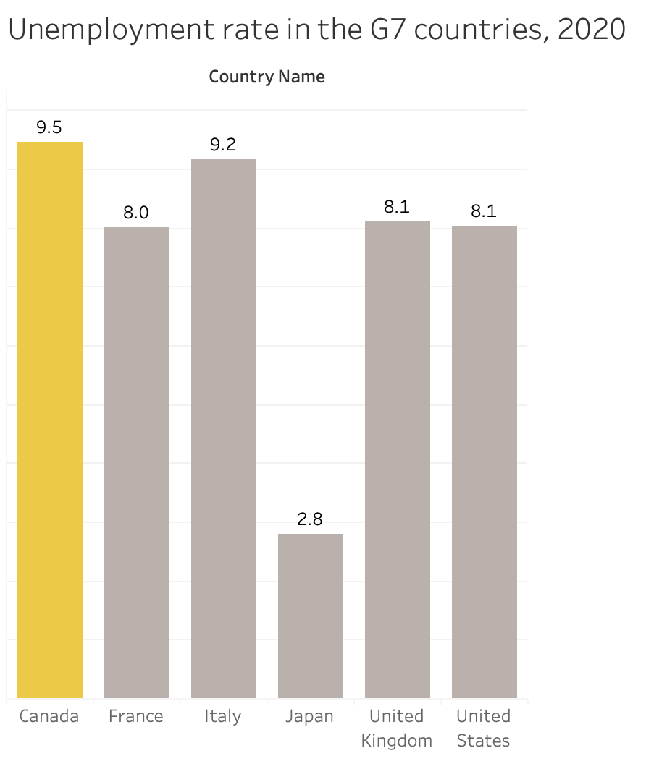
Canada, Compared to G7 Countries in 2020
Canada ranks:
3rd in the G7 countries in terms of life expectancy
4th in terms of urbanization rate
4th in terms of unemployment rate
Notes:
Presenter: CH

Slide 7
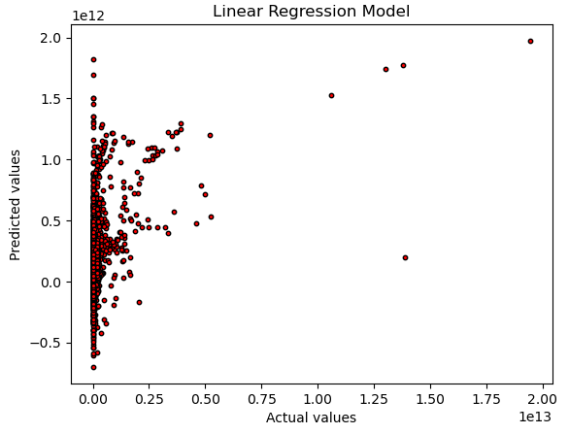
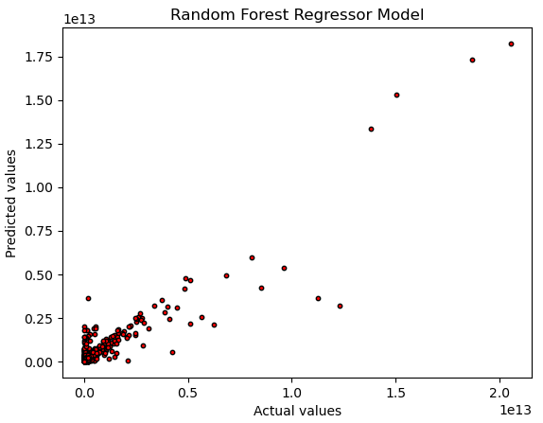
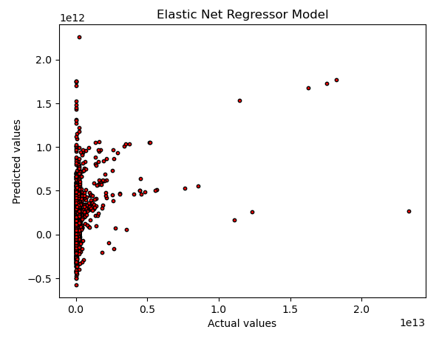
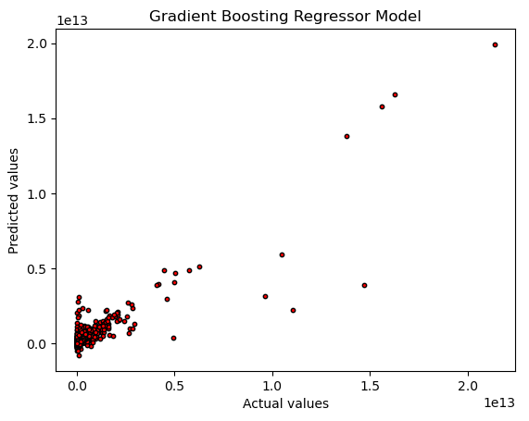
Machine Learning
Regression Models:
Multi Linear Regression
Elastic Net Regressor
Random Forest Regressor
Gradient Boosting Regressor
Notes:
Presenter: CH

Slide 8
Performance
Results:
Random Forest Regressor is the best performing model.
Gradient Boosting Regressor model could potentially be overfitting.
Linear Regression and Elastic Net Regressor were not appropriate models for our data.
Notes:
Presenter: CH

Slide 9
Conclusion
Summary
Potential Research
Organizations
Government Policies
Business Investors
Notes:
Presenter: CH

Slide 10
Thank you

